Slide 1
Checks and Balances: Fighting Myths with Facts
Kathleen Gasparian, Gasparian Immigration
504 262 9878
kathleen@gasparianimmigration.com

Slide 2
https://youtu.be/JUDSeb2zHQ0

Slide 3
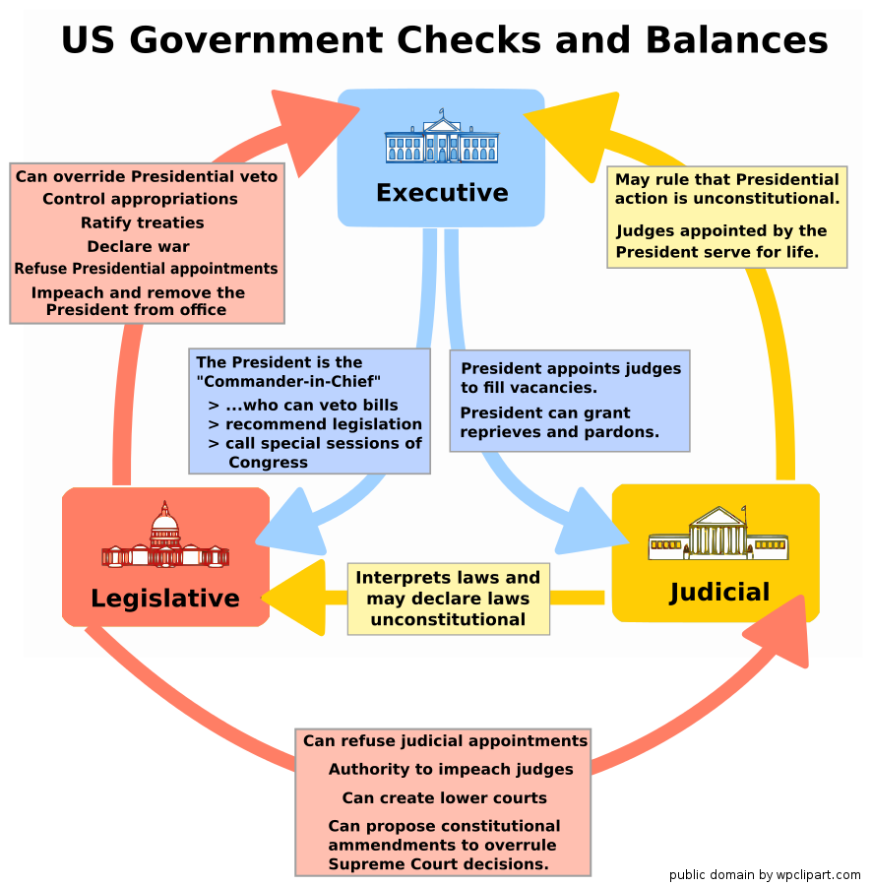
Constitution = Supreme law of the land!
And don’t forget – also have interplay of federal vs. state vs. local powers

Slide 4
Which branch “makes law”?
All of them
Legislative branch
Enact legislation (Write statutes)
X sponsors -> Committee -> Debate/vote -> Moves to House/ Sen -> committee -> debate/vote -> approval – President has 10 days to sign or veto.
Judicial branch
Interprets legislation and administrative law
Determines validity of legislation and administrative/executive actions
Executive branch
Implements and enforces the law
Agencies engage in administrative law making
Other actions

Slide 5
Executive “law making” - Agencies
Agencies
Agencies are given the authority to create administrative law through laws enacted by Congress.
The law comes in the form of rules, regulations, procedures, orders, and decisions.
In creating these "laws," the agency acts as quasi-judicial, quasi-legislative entity.
The process of administrative agency rule-making from the initial notice of agency interest to the promulgation of a final rule is documented in the Federal Register publication system. The two main components of this system are:
the Federal Register - Administrative agencies propose and announce regulations to carry out legislative mandates
the Code of Federal Regulations - Regulations are codified and incorporated into the existing body of regulations arranged by subject
Federal agencies, when issuing rules, have to follow the steps laid out in the Administrative Procedure Act of 1946. Proposed rules and final rules are initially published in the Federal Register; after the publication of the final rule, the rules that are currently in force are organized by subject and published annually in the Code of Federal Regulations.

Slide 6
Other types of agency actions
"Non-legislative rules" - "statements of policy" or "guidance"
Guidance
guidelines
agency staff manuals
staff instructions
opinion letters
press releases
Notes:
The two terms are not synonyms, only closely correlated: statements of policy are almost always issued in documents classified as guidance, and guidance documents to the public often include statements of policy.) Guidance and statements of policy are not legally binding on the public because they have not gone through the required procedures to become "legislative" rules binding on the public (depending on the rule, hearing, notice, comment, publication). However, when stated in mandatory language, they can bind the agency itself. They have only hortatory effect on the public, and those affected can challenge the agency's right to enforce the policy statement or guidance against the public.
In the late 1990s and early 2000s, many agencies were bypassing the APA’s requirements for rulemaking by tucking rules into informal documents like agency staff manuals and the like.

Slide 7
Executive “law making” - President
Executive Action – catch all term. Can mean anything from a policy wish list to an “order”. Most executive actions do not carry legal weight.
Executive Order
a directive issued to federal agencies, department heads, or other federal employees by the President of the United States under his/her statutory or constitutional powers
Call to take action or change practice
Once signed sent to federal register for publication
Can’t have an order that violates existing law
Executive Memorandum – historically has meant a directive w/o the formality of an order. Are not submitted to the Federal Register
Executive Proclamation – largely ceremonial/ no legal effect

Slide 8
How does all of this impact immigration?
Legislative
New legislations = new law
Proposed bills – no impact
Judicial
Recent examples – OPT, TPS and adjustment
Common – what crimes involve moral turpitude
Stop executive actions

Slide 9
How does all of this impact immigration?
Executive
The recent spectrum
Overturn of DACA memorandum
Executive Order – Travel ban
Executive Order – Hire American Buy American
Non-regulatory agency actions – changes in Foreign Affairs Manual
Revocation of policy memorandum regarding prosecutorial discretion
Super informal – level 1 wage/ H1B issues
Nonrenewal of TPS
Sanctuary city “sanctions”
Change in how agency classifies certain kids
Reduction in refugee admissions
Extreme vetting
The wall

Slide 10
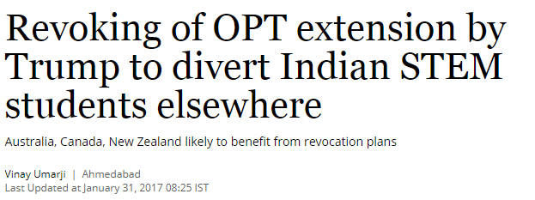
Myth vs. Fact
“OPT allows foreign STEM students to extend their stay in the US after completion of studies for 6-12 months under student visa. Foreign students are found to make use of OPT to either look for jobs or apply for further education or simply float around till the OPT term expires. The regime of previous US president Barack Obama had looked to extend the same to over three years but ran out of time with the country going into elections.
However, now the Trump administration has prepared a draft that looks to revoke extension of OPT. What's more, according to Indian education consultants, the new administration could altogether revoke OPT which could also impact students planning to study abroad in the US.”
Rule-Making vs. Executive Order
Go to the source!
Study in the States
CFR
http://www.business-standard.com/article/current-affairs/trump-s-stance-on-opt-extension-may-divert-indian-stem-students-elsewhere-117013001021_1.html

Slide 11
Myth vs. Fact
“The US has announced it is reducing visa services at its diplomatic facilities in Turkey for security reasons after one of its employees was detained at the Turkish consulate.
The move means that Turks will not be given visas to visit the US unless they are planning to move there.”
“The statement said the suspension of non-immigrant visa services was “effective immediately” to minimise visitor numbers to the US Embassy and Consulate for now. ”
Can you spot the fact?
Can you spot the myth?
Make sure that you read everything and go to the source!
http://www.independent.co.uk/news/world/americas/usa-partly-suspends-visa-services-turkey-a7989771.html

Slide 12
Be informed
Hone your fact vs. myth discernment skills—others need to trust that you know what you’re talking about
Resources
Trusted immigration attorneys – make friends with one in your area and/or sign up for an email newsletter
Community Organizations
Be careful not to spread rumors on your personal social media
Learn about the topics your specific student population cares about (ex. travel, encounters with law enforcement, work authorization, DACA, etc.)

Slide 13
Myth Busting
Is that something that branch of government can do?
Is it true?
Fake news
Look to the source
Does it make sense?

Slide 14
Communication strategies
Be proactive - If government action affects your students, reach out to affected student population with resources, message of care, etc. Messaging should include the facts and emphasize that you are well-informed and will update them as needed.
Website – have an immigration resource hub with direct links to government websites
Email, social media
Town hall meetings for drastic government action that affects your students – consider inviting people in positions of authority/knowledge, take written questions
1:1 advising – be prepared to listen a lot. Could include personal concerns (empathize, help when possible) and rumors (debunk!)
Don’t be afraid to say “I don’t know”

Slide 15
Communicating with the community
Build good working relationships with:
Government relations office and general counsel on campus
Local CBP office
Local nonprofits like ACLU
(Private) Facebook group for concerned community members who have volunteered to help
Resources on campus – collaborate!
Student legal services
Active student groups

Slide 16
What can I do to affect change?
Strategically educate and communicate
Connect-the-dots
Current problems to policy issues.
Build partnerships
Government relations and public affairs
Offices with like-minded needs
Community organizations

Slide 17
Advocacy
Definition of Advocacy (YourDictionary):
“The act of speaking on the behalf of or in support of another person, place, or thing.” (yourdictionary.com)
Synonyms of an Advocate:
backer, campaigner, champion, counsel, defender, expounder, pleader, proponent, proposer, speaker, spokesperson, supporter, upholder.
Definition of an Educator:
“A person who provides instruction or education; a teacher.” (google.com; “’educator’ definition”)

Slide 18
Myth busters
See an attorney (a good one)
Don’t assume there is no solution or that it is the end of the world
Pay the money for the consult
Avoid scams and fear mongers
Be wary of text messages
Be wary of emails
Be wary of “notarios”, “travel agents”, “friends” and “cousins”
Educate your students about what they can expect from attorneys
Be hesitant to trust “government” actors

Slide 19
Q&A

